Slide 1
MACHINE LEARNING PROJECT
Loan Approval Prediction
Using Ensemble Learning
Random Forest • XGBoost • LightGBM
S. Koushik — 2520090113
Ch. Ganesh — 2520090112
Guide: Dr. Y. Lakshmi Prasanna
Department of CS&IT | KLH University, Bachupally Campus
Academic Year: 2026–2027

Slide 2
Introduction
1
THE DOMAIN
2
WHY IT MATTERS
3
PROJECT IDEA
Loan approval is a classification problem: use applicant and financial attributes to estimate whether a loan application is approved or rejected.
Lenders need consistent, timely screening while considering repayment capacity, credit history, income and loan characteristics.
Explore the supplied loan dataset and develop a model-comparison pipeline using ensemble learning methods.
• The target variable in the supplied data is Loan_Status (Approved / Rejected).
• The experiment files first focus on data understanding and exploratory data analysis (EDA).
LOAN APPROVAL PREDICTION • ENSEMBLE LEARNING
2

Slide 3
Problem Statement
1
Mixed data
2
Manual assessment
Loan applications contain mixed numerical and categorical attributes, and some fields have missing values.
Manual assessment can be time-consuming and may produce inconsistent decisions across large application volumes.
3
Careful evaluation
4
Stakeholders
A predictive workflow must prepare the data carefully and evaluate model performance instead of relying on assumptions.
Stakeholders affected: applicants, loan officers, risk teams and financial institutions.
LOAN APPROVAL PREDICTION • ENSEMBLE LEARNING
3

Slide 4
Motivation
1
REAL-WORLD NEED
2
TECHNICAL LEARNING
3
MODEL COMPARISON
Loan screening is a practical decision-support use case where structured data can support more consistent review.
The project combines data inspection, missing-value analysis, EDA, feature preparation and supervised classification.
Random Forest, XGBoost and LightGBM provide three ensemble approaches to compare on the same task.
The goal is decision support—not automatic approval without human review, validation and fairness checks.
LOAN APPROVAL PREDICTION • ENSEMBLE LEARNING
4

Slide 5
Objectives
Understand the dataset structure, data types, target labels and data quality.
1
Explore missing values, duplicates, distributions, relationships and potential outliers.
2
Prepare the data for classification, including target/feature separation and train–test splitting.
3
Compare Random Forest, XGBoost and LightGBM using consistent evaluation metrics.
4
Present results and key factors in a clear, interpretable way.
5
LOAN APPROVAL PREDICTION • ENSEMBLE LEARNING
5

Slide 6
Existing System
1
MANUAL REVIEW
2
RULE-BASED SCREENING
3
KEY LIMITATIONS
Officers examine income, credit, employment, liabilities and supporting documents.
Fixed thresholds and policies can be useful, but may not capture complex interactions among variables.
High review effort, inconsistent edge-case handling and limited ability to learn patterns from historical data.
This presentation treats these as general baseline approaches; the supplied notebooks do not document a specific deployed legacy system.
LOAN APPROVAL PREDICTION • ENSEMBLE LEARNING
6

Slide 7
Proposed System
Use the supplied 20,000-record dataset as the starting point for analysis.
1
Inspect and clean data; handle missing values and exclude identifier fields from predictive inputs.
2
Train candidate ensemble classifiers on a consistent split and compare their metrics.
3
Generate an approval/rejection prediction with supporting evaluation and feature-importance analysis.
4
Keep the system as decision support with human oversight, fairness checks and documented limitations.
5
LOAN APPROVAL PREDICTION • ENSEMBLE LEARNING
7

Slide 8
System Architecture / Block Diagram
Loan dataset
(CSV)
Data audit
& EDA
Preprocessing
& encoding
Ensemble models
RF / XGB / LGBM
Evaluation & output
metrics / prediction
Inputs: applicant profile, income, liabilities, credit and loan details. | Output: predicted class and measured model performance.
The supplied experiment notebooks establish data understanding and EDA; training/evaluation stages are the intended model-development pipeline.
LOAN APPROVAL PREDICTION • ENSEMBLE LEARNING
8

Slide 9
Methodology / Workflow
1
2
3
4
Load CSV
Inspect schema
Analyze missingness
Explore patterns
5
6
7
8
Preprocess
Split data
Train models
Evaluate & compare
Repeat with the same split and metric definitions to make model comparison fair.
LOAN APPROVAL PREDICTION • ENSEMBLE LEARNING
9

Slide 10
Technology Stack
Language
Data handling
ML framework
Python
Pandas, NumPy
scikit-learn
Boosting models
Visualization
Environment
XGBoost, LightGBM
Matplotlib, Seaborn
Jupyter Notebook / Google Colab / VS Code
Database/cloud deployment is not established in the supplied experiment notebooks.
LOAN APPROVAL PREDICTION • ENSEMBLE LEARNING
10

Slide 11
System Modules / Components
Data ingestion
Data quality
EDA
Load the CSV and verify shape, columns and types.
Check nulls, duplicates and inconsistent labels.
Study distributions, approval rates, correlations and outliers.
Preprocessing
Model training
Evaluation
Impute missing values, encode categories and scale if required by model.
Fit Random Forest, XGBoost and LightGBM.
Compare accuracy, precision, recall, F1-score and confusion matrices.
LOAN APPROVAL PREDICTION • ENSEMBLE LEARNING
11

Slide 12
Implementation
Load the dataset using Pandas and inspect shape, columns, data types and summary statistics.
1
Calculate missing-value counts and percentages; check duplicate rows and the target distribution.
2
Use EDA plots to inspect numeric distributions, categorical approval rates, correlations and outliers.
3
Prepare a preprocessing pipeline so imputing/encoding is learned from training data only.
4
Train and evaluate each model on the same held-out test set; record results in a comparison table.
5
Implementation status reflected by supplied notebooks: Experiment 1 = data understanding; Experiment 2 = EDA.
LOAN APPROVAL PREDICTION • ENSEMBLE LEARNING
12

Slide 13
Dataset / Input Data
RECORDS
COLUMNS
TARGET
20,000
39
Loan_Status
loan applications
total columns
Approved / Rejected
Representative input features
Data quality observations
Age • Monthly_Income • Annual_Income
Credit_Score • Existing_Loans • Monthly_EMI
Loan_Amount • Loan_Tenure • Interest_Rate
Employment_Type • Education • Loan_Purpose
Duplicate rows: 0
Fields with missing values: 9
Examples: Property_Value, Loan_to_Value, Collateral_Value, Other_Income, Investments
Application_ID is an identifier and should not be used as a predictive feature.
LOAN APPROVAL PREDICTION • ENSEMBLE LEARNING
13

Slide 14
Algorithm / Model
1
RANDOM FOREST
2
XGBOOST
3
LIGHTGBM
Combines many decision trees trained on bootstrapped samples; averages/votes to improve robustness and reduce variance.
Gradient-boosted trees optimize a loss function sequentially and include regularization for predictive performance.
Gradient boosting designed for efficient training on tabular data using histogram-based learning and leaf-wise tree growth.
Why compare them? All are tree-ensemble methods, but they learn patterns differently. The best model must be selected from measured validation/test results—not assumed in advance.
LOAN APPROVAL PREDICTION • ENSEMBLE LEARNING
14

Slide 15
Results
1
DATA UNDERSTANDING
2
DATA QUALITY
3
MODEL METRICS
20,000 records • 39 columns • target: Loan_Status
9 columns have missing values; duplicate rows: 0.
Accuracy, precision, recall, F1-score and confusion matrix should be reported after model evaluation.
The uploaded notebooks contain data understanding and EDA. They do not provide trained-model metrics, so no accuracy or winning model is claimed in this presentation.
Recommended comparison: evaluate all three models on the same held-out test set.
LOAN APPROVAL PREDICTION • ENSEMBLE LEARNING
15

Slide 16
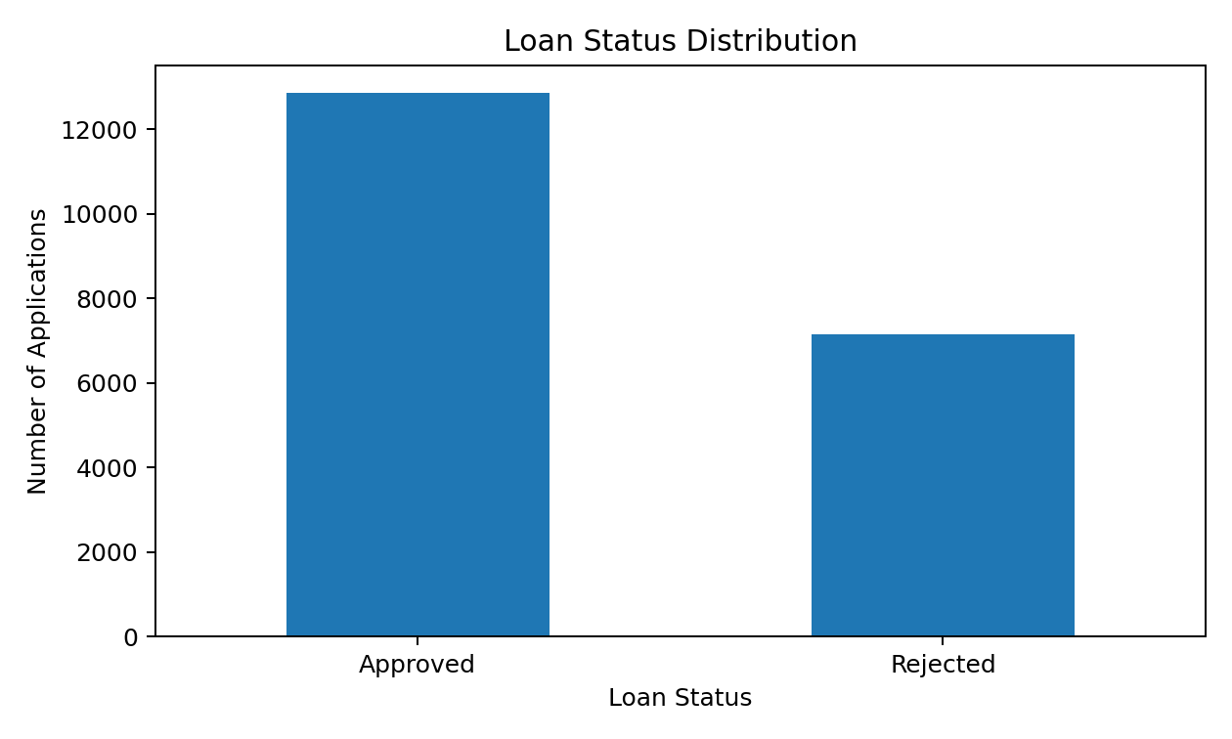
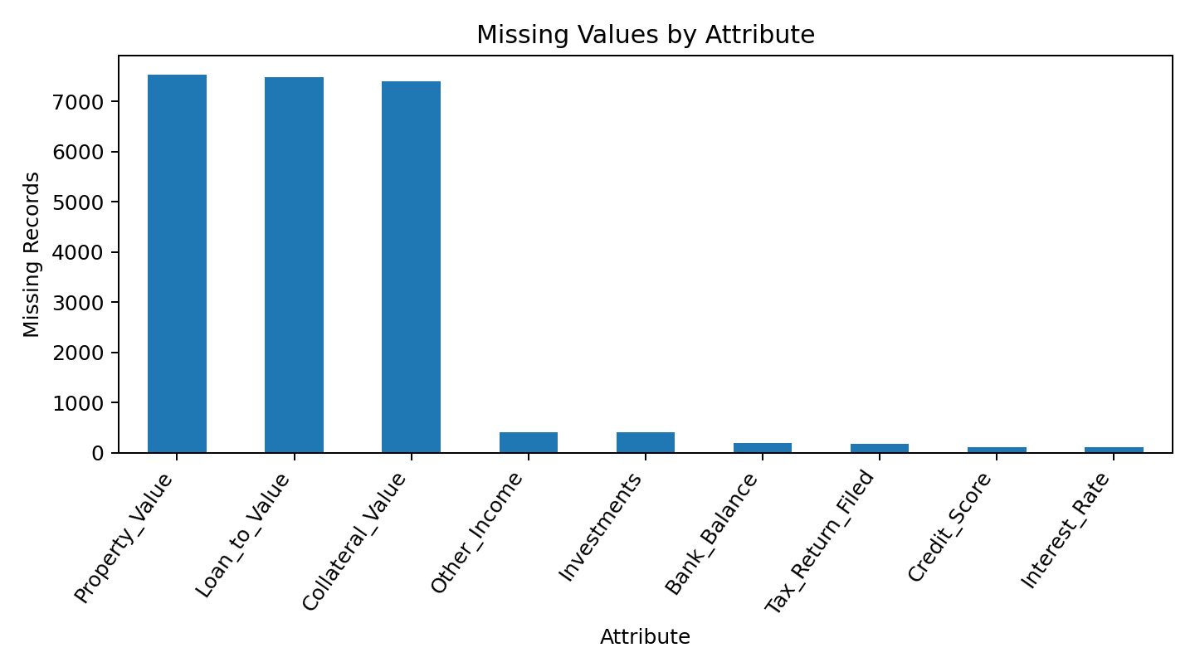
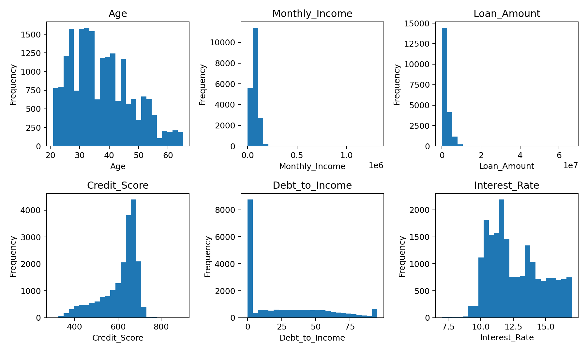
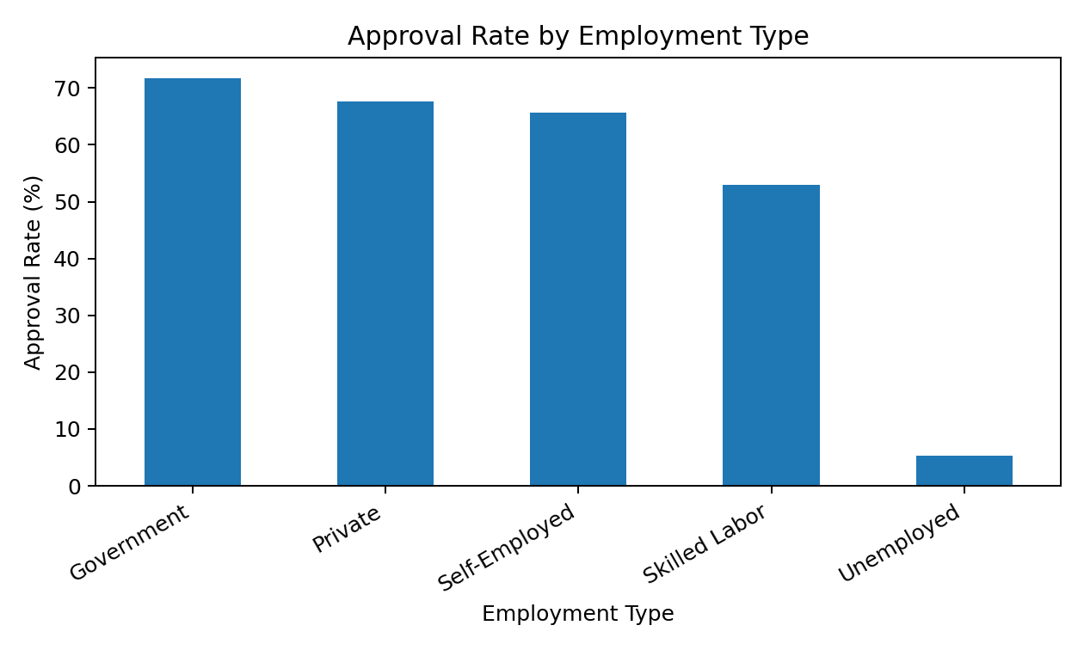
Screenshots / Demo
Loan status distribution
Missing values
Numerical distributions
Approval by employment
LOAN APPROVAL PREDICTION • ENSEMBLE LEARNING
16

Slide 17
Advantages
Repeatable workflow for inspecting and preparing loan application data.
✓
EDA helps identify missingness, skewed distributions, relationships and potential outliers before modelling.
✓
Comparing multiple ensemble methods can reveal trade-offs in predictive performance.
✓
Evaluation metrics provide a more complete picture than accuracy alone, especially if target classes are imbalanced.
✓
Can support human reviewers by prioritizing applications for further assessment.
✓
LOAN APPROVAL PREDICTION • ENSEMBLE LEARNING
17

Slide 18
Applications
1
BANKS & NBFCS
2
RISK ANALYTICS
3
OPERATIONS
Decision support for personal, consumer or other retail loan applications.
Explore applicant risk patterns and investigate factors associated with historical outcomes.
Assist triage and prioritize applications for manual review, subject to policy and validation.
Any real-world deployment requires privacy safeguards, fairness testing, regulatory review and a human appeal path.
LOAN APPROVAL PREDICTION • ENSEMBLE LEARNING
18

Slide 19
Limitations
The provided notebooks document data understanding and EDA; model-training and evaluation results are not included.
!
Missing values require a documented, leakage-safe preprocessing strategy.
!
Historical loan decisions can contain bias and may not represent future applicants.
!
Accuracy alone may hide poor recall for one class; several metrics and subgroup checks are needed.
!
Predictions do not explain every decision and must not replace responsible lending review.
!
LOAN APPROVAL PREDICTION • ENSEMBLE LEARNING
19

Slide 20
Future Scope
Complete preprocessing, train/test split and model training for Random Forest, XGBoost and LightGBM.
1
Use cross-validation and hyperparameter tuning, then compare metrics on a held-out test set.
2
Add confusion matrices, ROC-AUC/PR-AUC and feature-importance or SHAP explanations.
3
Perform fairness and subgroup analysis; document privacy and governance controls.
4
Build a simple Streamlit interface and version the trained model for a controlled demo.
5
LOAN APPROVAL PREDICTION • ENSEMBLE LEARNING
20

Slide 21
Conclusion & References
CONCLUSION
REFERENCES / TOOLS
The project establishes a data-understanding and EDA foundation for loan approval prediction using a 20,000-record dataset. The next stage is to train and fairly evaluate the three proposed ensemble models.
• Supplied files: ML Abstract.pdf
• Experiment1_ML_Corrected.ipynb
• experiment2_ML_Corrected.ipynb
• Pandas and NumPy documentation
• scikit-learn documentation
• XGBoost documentation
• LightGBM documentation
LOAN APPROVAL PREDICTION • ENSEMBLE LEARNING
21

Slide 22
Thank you

